Slide 1
Human and Economic Toll of Hurricanes
Presented by Tushar Muley
January 9, 2022
Bellevue University DSC 680 | Professor B. Werner

Slide 2
The Path of Our Presentation
Intro
Hurricane background
A hurricane story
Some interesting facts about hurricanes
Hurricane energy (There big, there bad they pack a punch)
Deaths caused by past hurricanes
Predicting hurricane related deaths (Can we predict death?)
Economic damage due to hurricanes
Predicting economic loss
The aftermath of hurricane (Friend or Foo?)
2

Slide 3
Hurricanes - Background
What do I call them?
Life cycle of a hurricane
How are hurricanes named?
How is the intensity of a tropical storm determined?
3

Slide 4
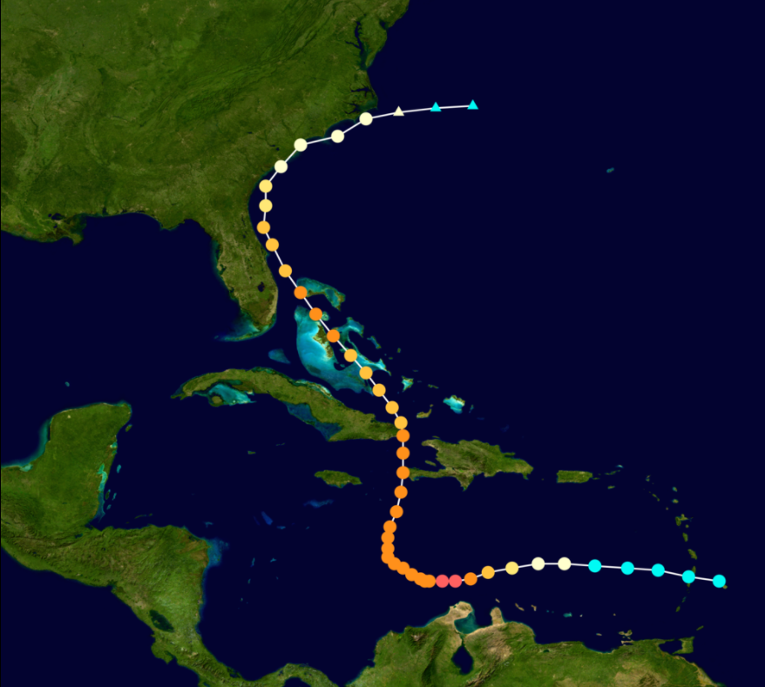
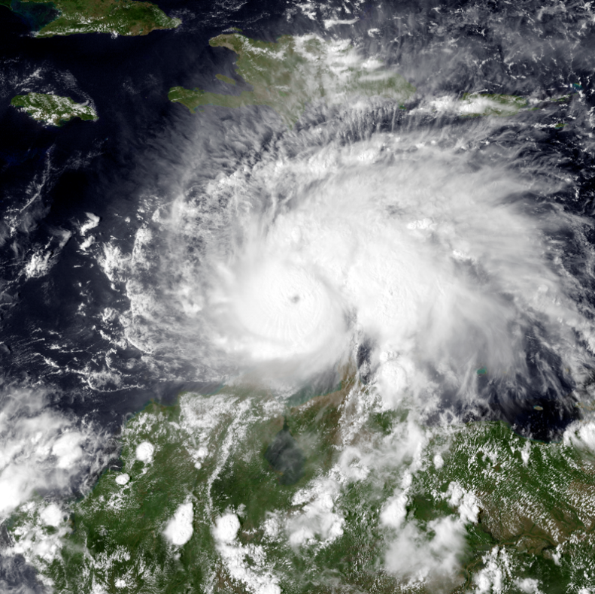
Hurricane Matthew - 2016
14th Named Storm turned into a Hurricane
Lasted from Sept 28th – October 9
Category 4 when it came on shore in Florida
4

Slide 5




Hurricanes – Impact to Humans and Economy
Hurricane Season
June 1st – November 30th
Number of Hurricanes – 21
12 named storms | 6 hurricanes | 3 Major Hurricanes
Number of Hurricanes Related Deaths
Average 50 | 96 Deaths in 2021
Economic Impact
$997.3 billion Total Damages (btw 1980 – 2020) | $22 billion (in 2020 alone)
5

Slide 6
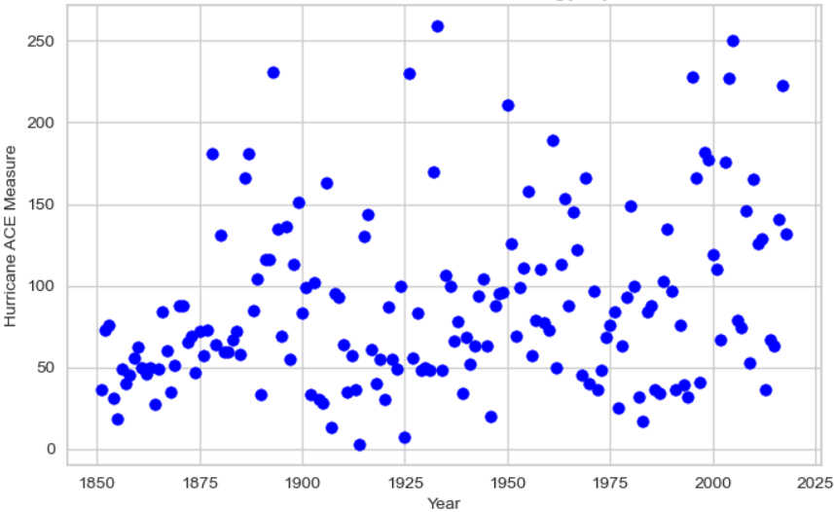
Energy of Hurricanes
Hurricane ACE Scatter Plot by Year
Accumulated Cyclone Energy (ACE) – How hurricane energy is measured
U.S. had one major storm every 10 to 50 year between 1850 – 1950
Between 1995 – 2020 we have seen the same number of storm in short amount of time
6

Slide 7
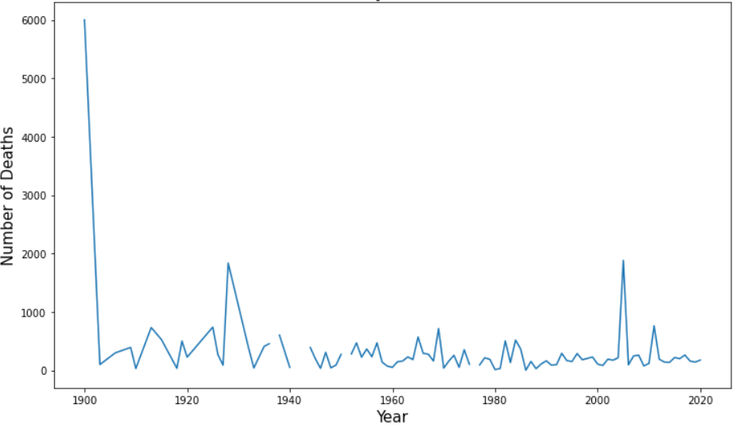
Deaths Related to Hurricanes
Number of Deaths Related to Hurricanes
143 People lost their lives between 2020 – 2021 due to hurricanes
2021 was most deadliest year since 2017
7

Slide 8
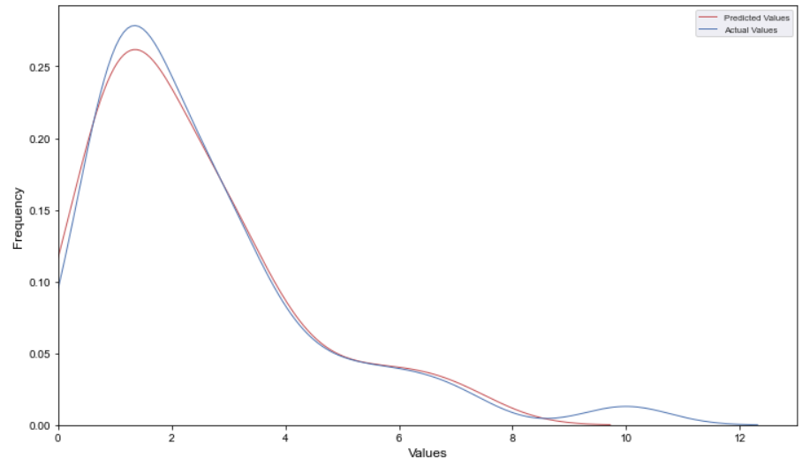
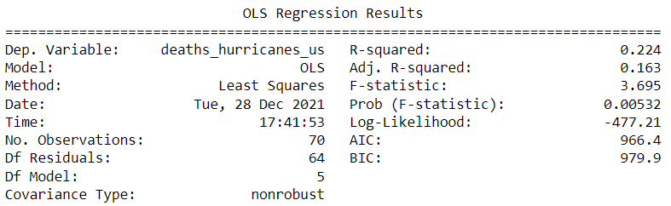
Predicting Deaths
Line Chart of Predicted Compared to Actuals for Death Related to Hurricanes
3 Different Models
With and without binning Death
Ordinary Least Squares
R Squared = 0.224
8

Slide 9
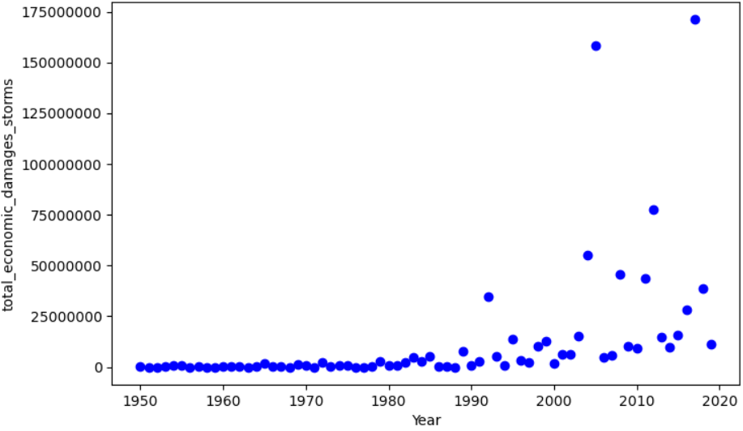
Economic Damage
Scatter Plot of Economic Damage Related to Hurricanes
Hurricane have caused on average of $21.5 billion per event
36% of the U.S. population is on the East Coast
9

Slide 10
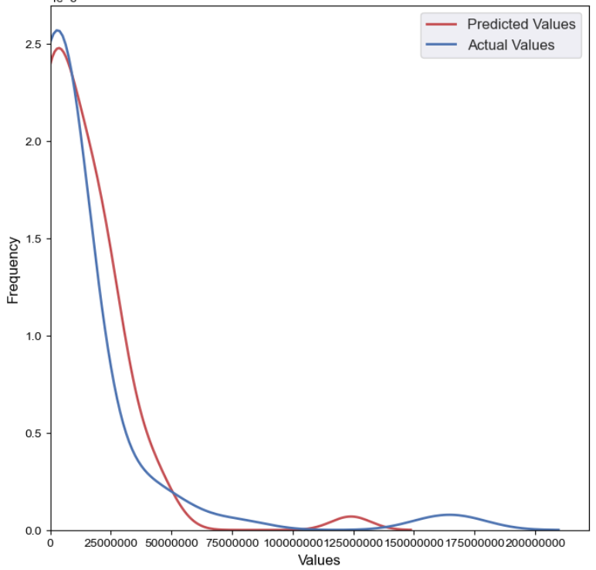
Predicting Economic Damage
Scatter Plot of Economic Damage Related to Hurricanes
3 Different Models
Ordinary Least Squares
R Squared = 0.410
10

Slide 11
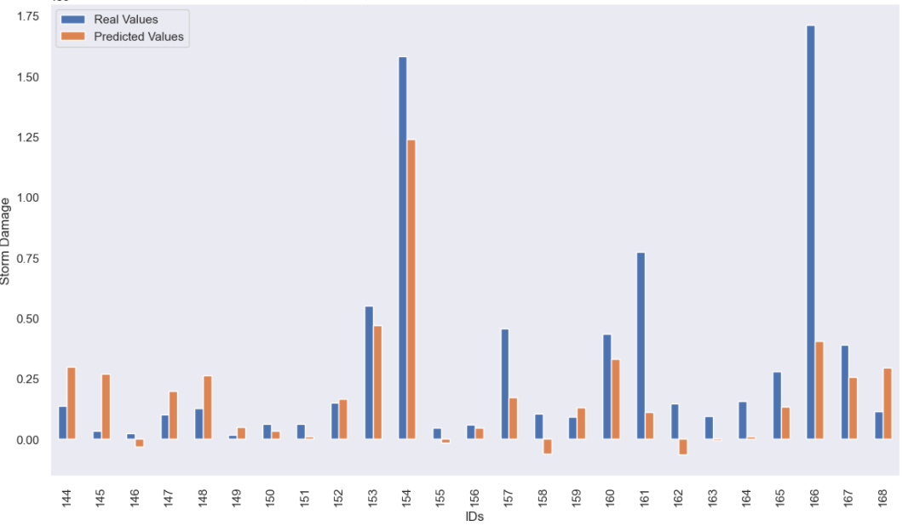
Predicting Economic Damage Cont..
Bar Graph of Predicted vs. Actuals for Economic Damage Hurricanes
11

Slide 12
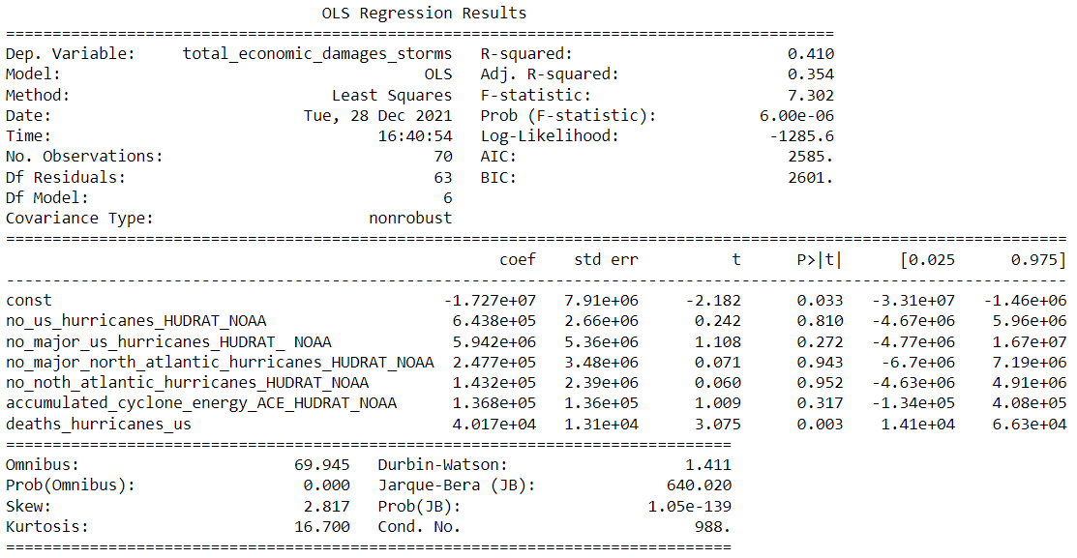
Predicting Economic Damage Cont..
OLS Regression Results
R2 – 0.410 of 41%
Adjusted R2 – 0.354
Number of observations 70
12

Slide 13
Conclusion
Model used for Predicting Deaths Related to Hurricanes
Linear Regression model had an R² -2.41
OLS model without binning R² 0.224
OLS model with binning R² 0.095
This was not ideal I believe more detail data and different data is needed to improve the prediction of deaths
Categorizing the deaths would assist the model
Model used for Predicting Economic Damage Related to Hurricanes
Reduced data from 1950 forward only
Decision Tree model R² of 0.025
OLS model R² of 0.410
Data seems better used for Economic Damage compared to Deaths
R² of 0.410 is not great there is room for improvement using another model
13

Slide 14

Thank you.
14

